Slide 1


Sophia Mwinyi
9th September 2024

Slide 2

Outline
Executive Summary
Introduction
Methodology
Results
Conclusion
Appendix

Slide 3
Executive Summary
The main goal of this project is to analyse SpaceX Falcon 9’s historical data collected from various online sources and use predictive machine learning models to determine the success rate of first stage landing that provides other space agencies with valuable insights to bid against SpaceX.
Methodology
The following methods were used to collect and analyse the data, build and evaluate machine learning models for prediction
Data collection from SpaceX’s website API and Web scrapping from Wikipedia
Data wrangling and transformation
Data exploration and visualisation using SQL and plots
Data mapping using folium
Building an Interactive dashboard using Plotly Dash
Build a predictive machine learning models to predict whether the first landing of Falcon 9 will land successfully or not.
Results
In summary, this reports show that:
Successful landings are more likely with an increase in flight number and certain orbits (ESL, GEO, HEO, SSO, VLEO)
Heavier payloads perform better in Polar, LEO, and ISS orbits.
The success rate of landings has steadily improved since 2013, peaking after 2015.
A decision tree classifier provided the highest accuracy, with 88% on the training set and 83% on the test set.

Slide 4
Introduction
Project Background
SpaceX has gained worldwide recognition for its groundbreaking achievements, including becoming the first private company to return a spacecraft from low-earth orbit in December 2010. One of its most notable innovations is the reusability of the Falcon 9 rocket's first stage, which allows SpaceX to offer launches at a significantly lower cost—around USD 62 million compared to competitors charging USD 165 million or more. This ability to reuse rocket stages not only reduces costs but also sets a new industry standard for space travel efficiency. Cost of launch continues to be a major barrier for new competitors in the space race market.
Problem Statements
Determine impact of different parameters on the first stage landing outcome of Falcon 9.
Assess the correlation between launch sites and ;landing success
Build a model using Falcon 9’s first-stage landing historical data that can predict future first-stage landing outcomes

Slide 5

Section 1

Slide 6
Methodology
Executive Summary
Data collection methodology:
Historical Falcon 9 launch records were collected via SpaceX’s REST API
Web scrapping from SpaceX’s Wikipedia page
Perform data wrangling
Missing values were handled by replacing the missing Payload Mass values with the mean and retaining missing Landing Pad values to represent cases where no landing pad was used.
Perform exploratory data analysis (EDA) using visualization and SQL
Perform interactive visual analytics using Folium and Plotly Dash
Perform predictive analysis using classification models
Classification models were built using Logistic regression, SVM, Decision Trees & KNN machine learning algorithms. The data was split into training and test sets, with hyperparameter tuning to optimize model performance. Model accuracy was evaluated based on the prediction accuracy on the test set.

Slide 7
Data Collection – SpaceX API
This project used data that was collected using get request to the SpaceX API to extract relevant historical SpaceX Falcon 9 launch data. The below flow chart represents the data extraction process using this method.
GitHub

Slide 8
Data Collection - Scraping
This project used data that was collected by web scrapping SpaceX’s Wikipedia page for extract historical SpaceX Falcon 9 launch data. The below flow chart represents the data extraction process using this method.
GitHub

Slide 9
Data Wrangling
In the dataset, missing values were identified in each attribute. 28% of the Landing Pad variable had missing values, which were replaced with the mean value.
The data contained various mission outcomes that were converted into Training labels 1 meaning the booster landed successfully and 0 meaning the booster did not land successfully during the first stage.
Missing values
Identify and calculate the percentage of the missing values in each attribute
Data Type
Launches count
Calculate the number of launches on each site
Identify which variables are numerical and categorical
Orbit occurrence
Create Landing outcome label
Assign the following: If the value is zero, the first stage did not land successfully; one means the first stage landed Successfully
Mission outcome
Determine the number of landing outcomes
Determine the number and occurrence of each orbit
GitHub

Slide 10
EDA with Data Visualization
To obtain more insight from the data, the following charts were plotted to give a summary of the data:
Scatter Plots
Scatter plots are plotted to show a relationship between two variables. In this case we plotted scatter plots to visualize:
Relationship between Flight number and Launch site
Relationship between Payload and Launch site
Relationship between Flight number and Orbit type
Relationship between Payload and Orbit type
Bar Plots
Scatter plots are plotted to show a relationship between a categorical and numerical variable. We used a bar plot to visualize:
The relationship between landing success rate and orbit type.
Line Plots
A line plot is used to show a trend over time of a particular numerical variable. Here, we have used it to:
Understand the average landing success rate over time (years).
GitHub

Slide 11
EDA with SQL
The following SQL queries were used to understand the SpaceX data:
Obtain the names of the unique launch sites in the space mission
Show 5 records where launch sites begin with the string 'CCA’
Calculate the total payload mass carried by boosters launched by NASA (CRS)
Compute average payload mass carried by booster version F9 v1.1
List the date when the first successful landing outcome in ground pad was achieved.
List the names of the boosters which have success in drone ship and have payload mass greater than 4000 but less than 6000
List the total number of successful and failure mission outcomes
List the names of the booster_versions which have carried the maximum payload mas
List the records which will display the month names, failure landing_outcomes in drone ship ,booster versions, launch_site for the months in year 2015
Rank the count of landing outcomes (such as Failure (drone ship) or Success (ground pad)) between the date 2010-06-04 and 2017-03-20, in descending order
GitHub

Slide 12
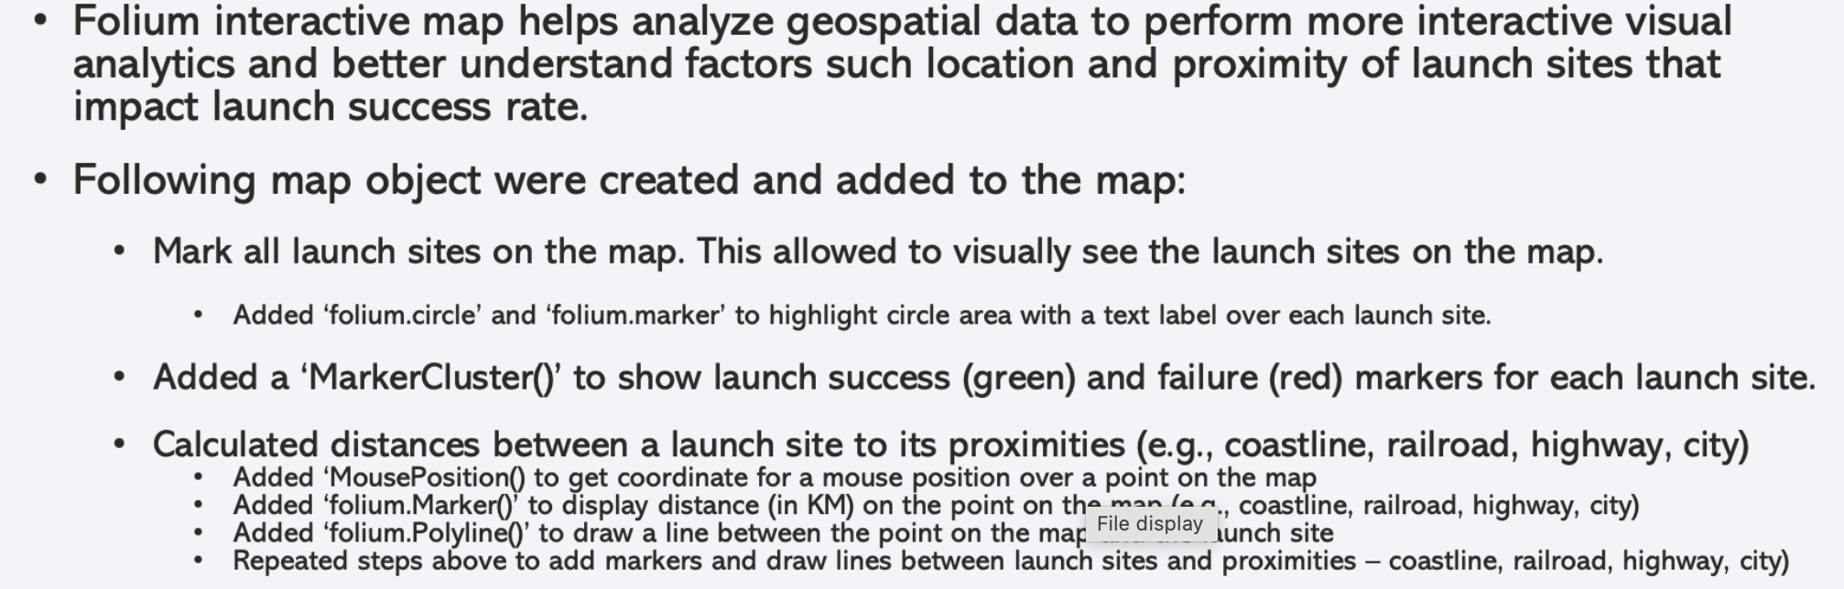
Build an Interactive Map with Folium
GitHub

Slide 13
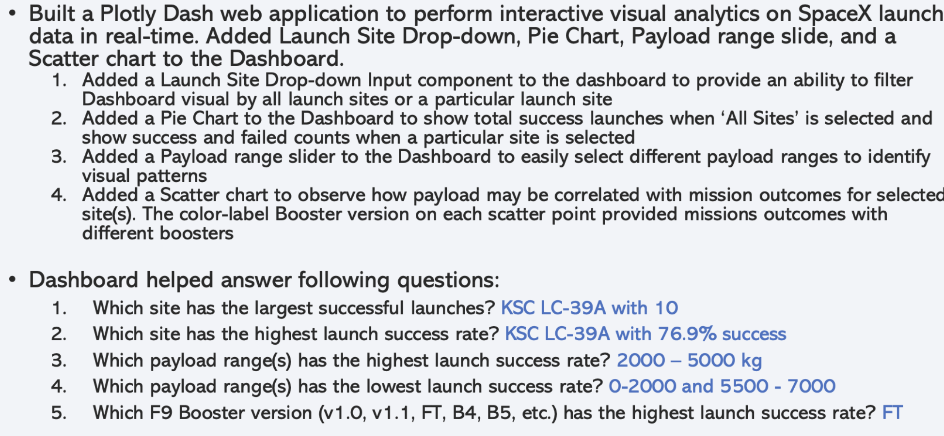
Build a Dashboard with Plotly Dash
GitHub

Slide 14
Predictive Analysis (Classification)
From the main data set, target variable array was created (Y) and the observations (X).
Numerical variables of the observations were standardized.
The dataset was splitted into a train and test set (80% and 20%, respectively).
Using the training set, models were trained using different machine learning algorithms including, logistic regression, SVM, kNN and Decision Trees.
A test set was used to assess the predictive performance of the trained models.
The decision tree classifier had the highest training set accuracy compared to other models.
All models achieved the same test set accuracy.
GitHub

Slide 15

Section 2

Slide 16
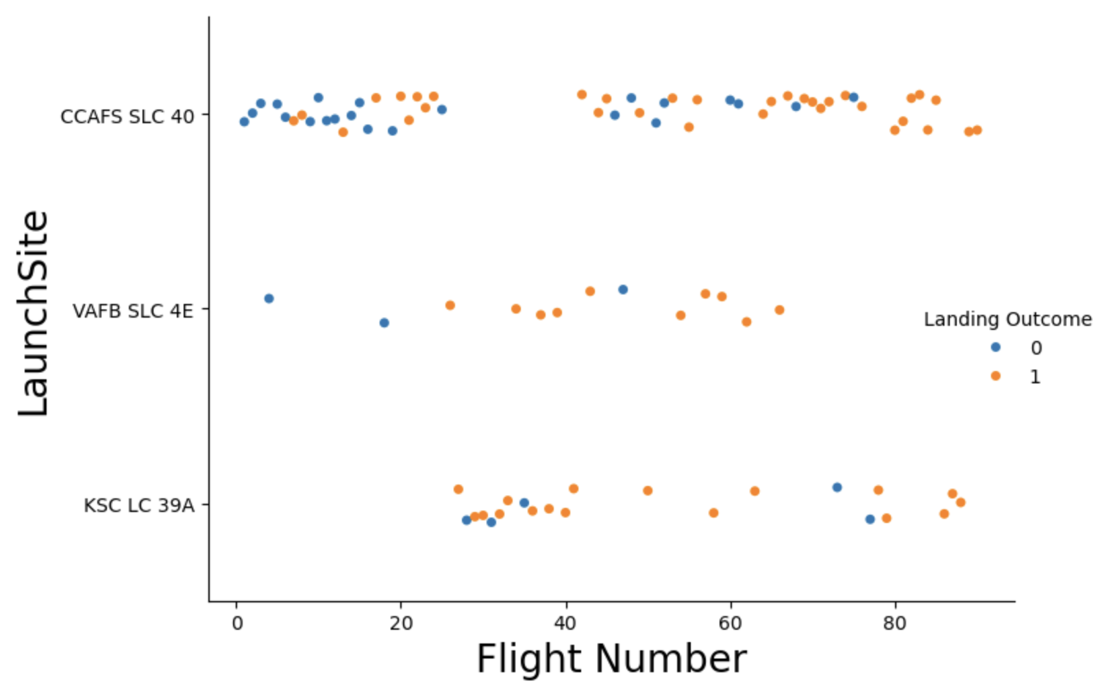
Flight Number vs. Launch Site
There is a non definite pattern which clearly shows the relationship between launch site and flight number. However, CCAFS SLC 40 has a higher likelihood of having success landing compared to others.s

Slide 17
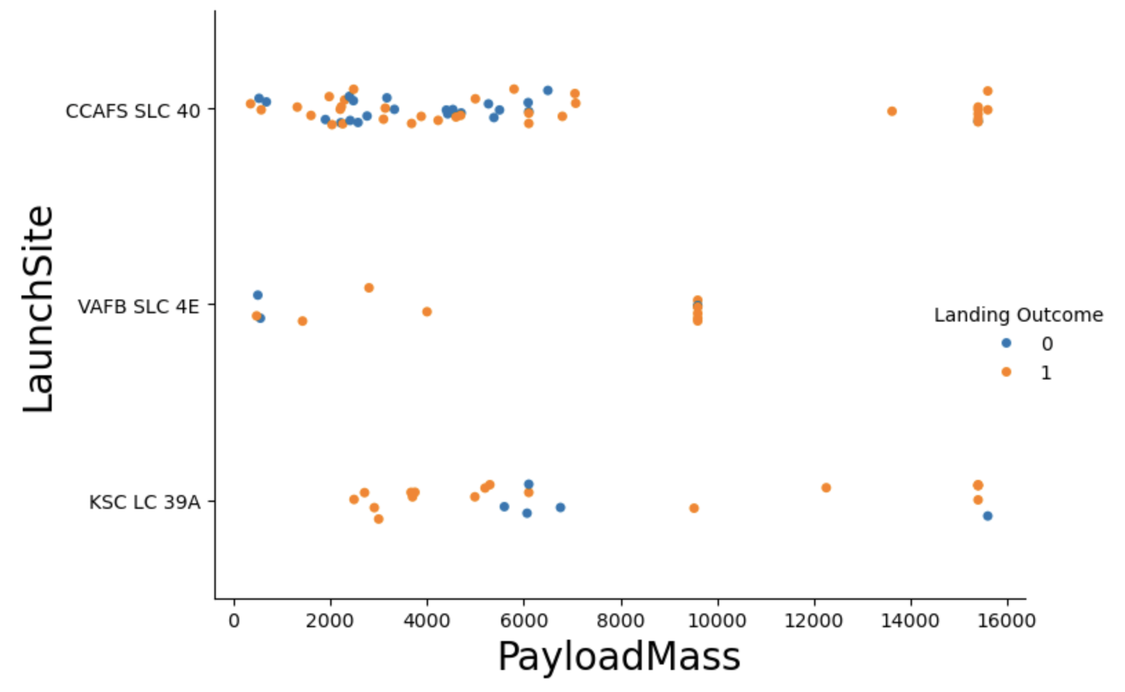
Payload vs. Launch Site
The higher the Payload Mass at launch site CCAFS SLC 40 the higher the likelihood of a successful landing.
For the VAFB-SLC launch site there are no rockets launched for heavy payload mass >10000. And at the highest payload, the greater the likelihood of success landing.

Slide 18
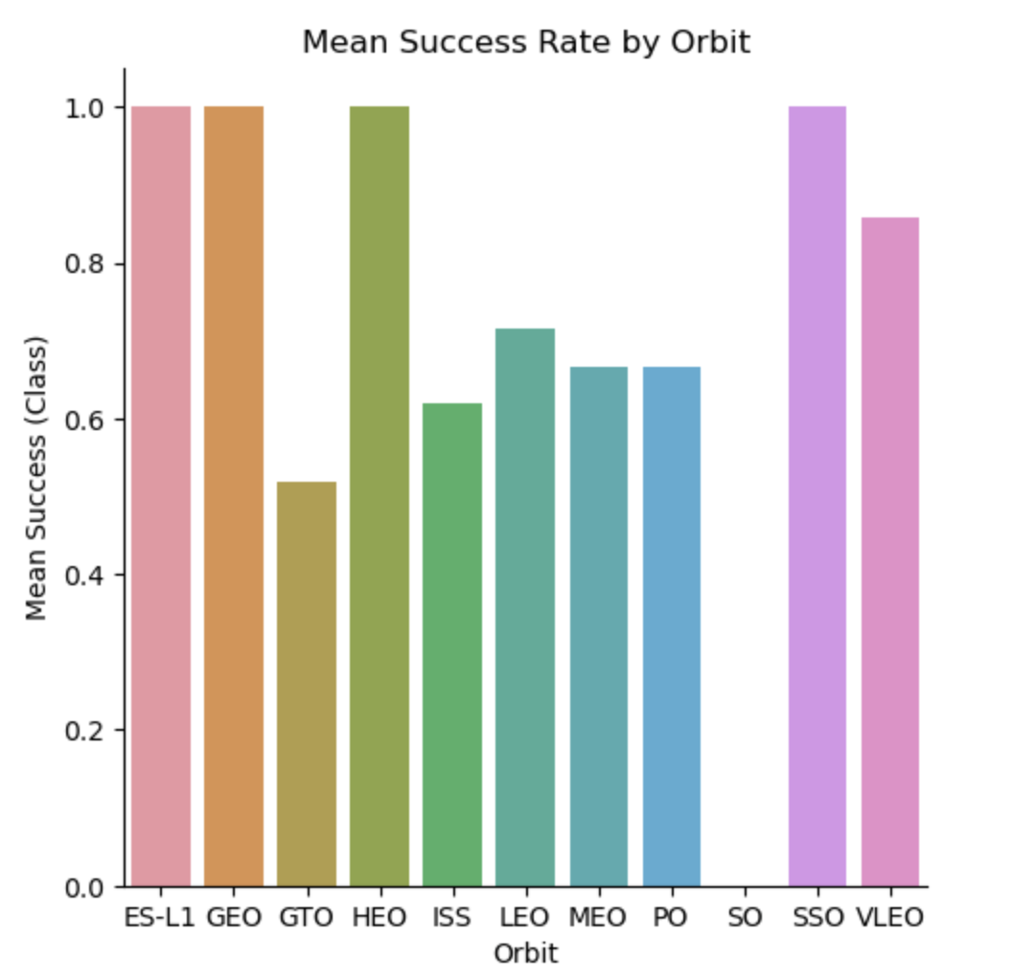
Success Rate vs. Orbit Type
On average, Orbits ES-L1, GEO, ISS and SSO have the highest chance of landing successfully to others.
Orbit GTO has the lowest average chance of landing successfully.

Slide 19
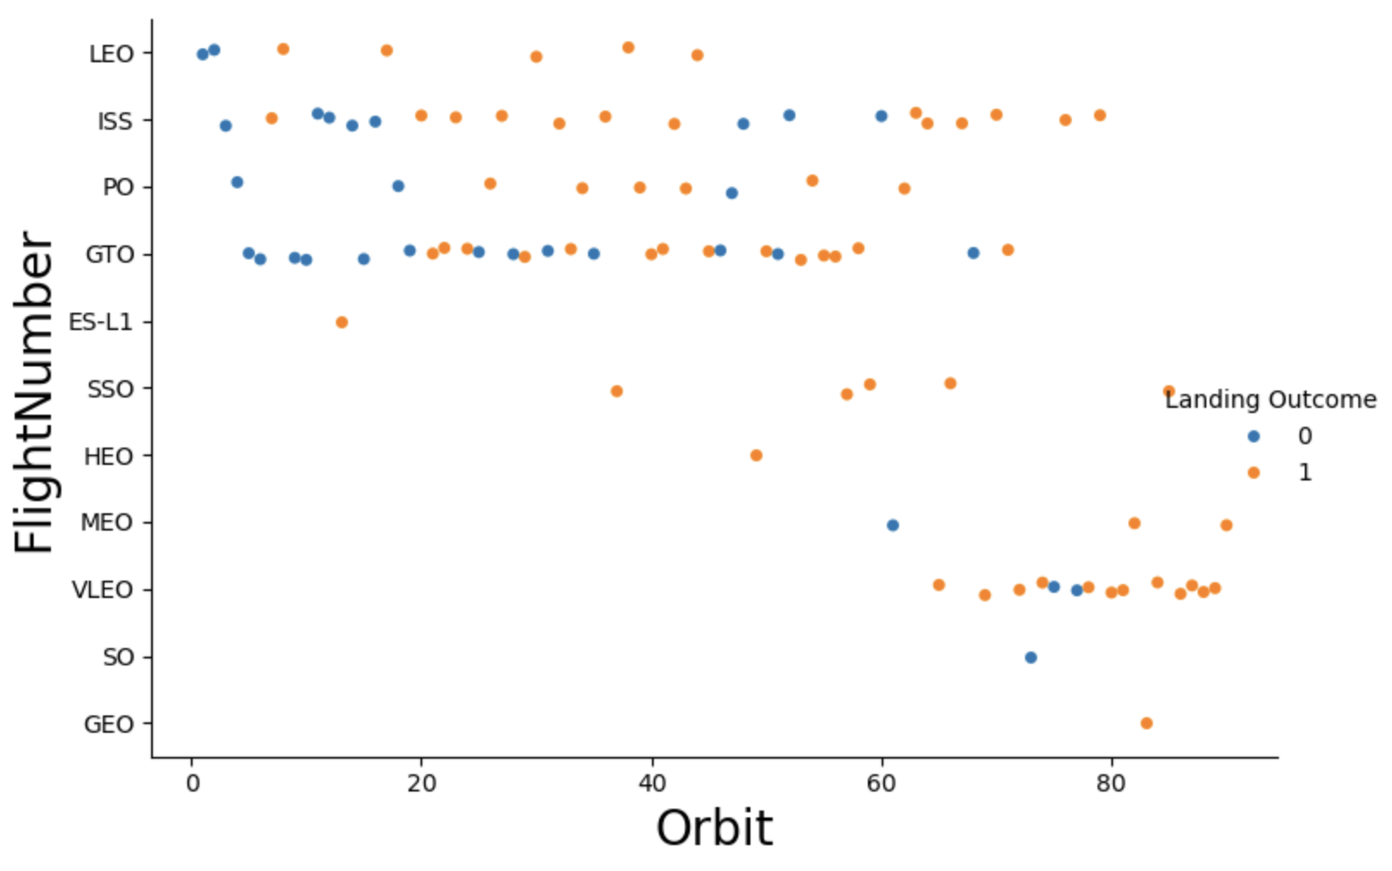
Flight Number vs. Orbit Type
While overall there is no definitive relationship between orbit type, flight number and landing status.
The LEO orbit landing success is related to the number of flights.
On the other hand, seems to be no relationship between flight number when in GTO orbit.

Slide 20
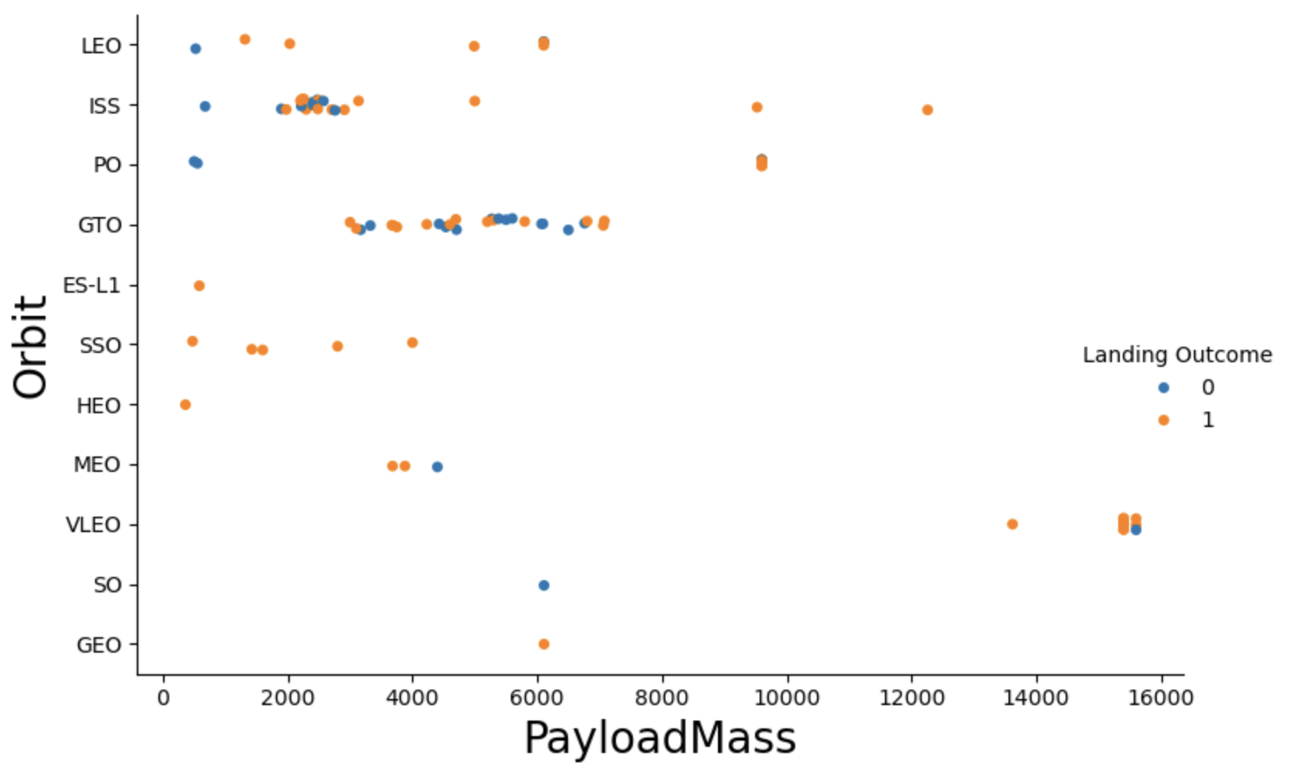
Payload vs. Orbit Type
With heavy payloads the successful landing or positive landing rate are more for PO, LEO and ISS.
for GTO we cannot distinguish this well as both positive landing rate and negative landing(unsuccessful mission) are both present.

Slide 21
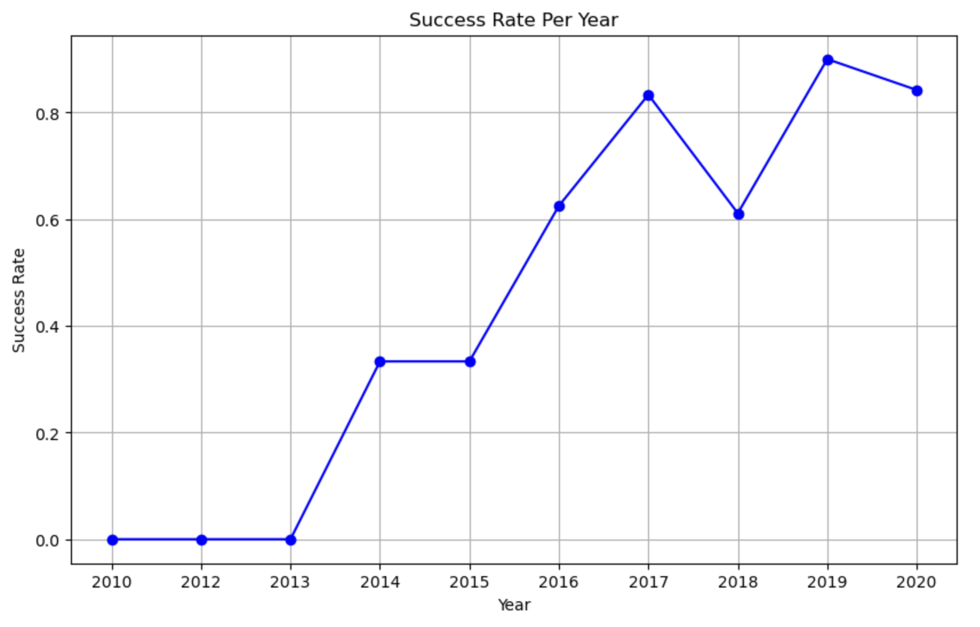
Launch Success Yearly Trend
The overall trend shows that the success rate keeps increasing over years.
While the success rate was stable from 2010-2013, if kept increasing thereafter till 2017 (stable in 2014) before it decline in 2018 and increasing again.

Slide 22
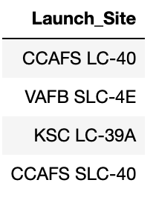
All Launch Site Names
Query:
Result:
Description:
DINSTINCT returns unique values from the “Launch_Site” variable Find the names of the unique launch sites
There are four launch sites in this data set

Slide 23
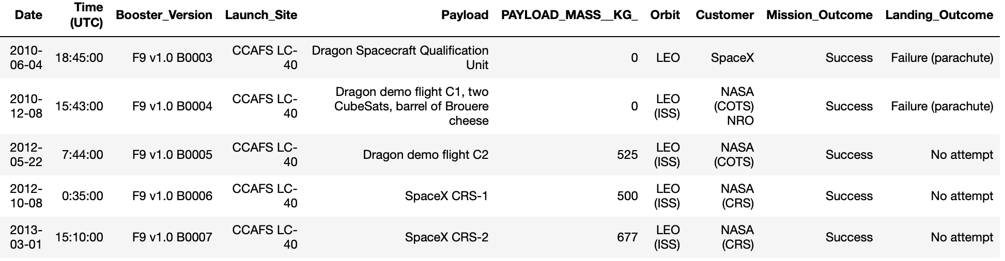
Launch Site Names Begin with 'CCA'
Query:
Result:
Description:
LIKE ‘CCA%’ returns values from the “Launch_Site” variable starting with the word CCA
LIMIT 5, limits the output to only 5 observations

Slide 24
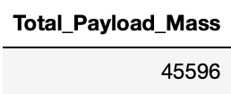
Total Payload Mass
Query:
Result:
Description:
SUM adds values of the variable “PAYLOAD_MASS_KG_) for customers name “NASA (CRS) and returns the total value in variable called Total_Payload_Mass which is 45596.

Slide 25
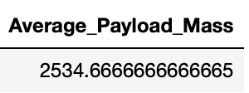
Average Payload Mass by F9 v1.1
Query:
Result:
Description:
AVG calculates the average value of the variable “PAYLOAD_MASS_KG_) for customers name starts with “F9 v1.1%” and returns the mean value in variable called Average_Payload_Mass which is 2534.667.

Slide 26
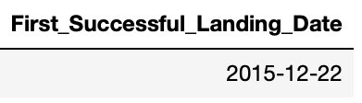
First Successful Ground Landing Date
Query:
Result:
Description:
MIN specifies the first or oldest ”Date” where landing outcome was successful on ground and returns it as a variable named First_Successful_Landing_Date which is 2015-12-22.

Slide 27
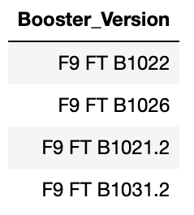
Successful Drone Ship Landing with Payload between 4000 and 6000
Query:
Result:
Description:
The query finds the booster version which landed successfully on drone ship and had pay load mass between 4000 – 6000
The and operate is what allows the clause to return a result where both conditions for the booster versions are true

Slide 28
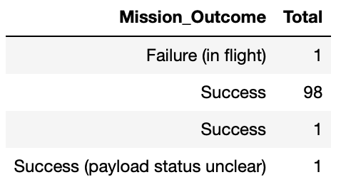
Total Number of Successful and Failure Mission Outcomes

Slide 29
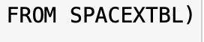
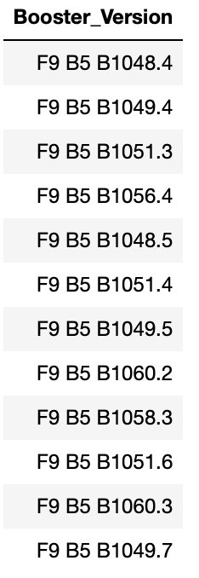
Boosters Carried Maximum Payload
Query:
Result:
Description:
This query filters the Booster Versions which have the maximum pay load mass value.

Slide 30
2015 Launch Records
Query:
Result:
Description:
The query lists mission outcome, landing outcome and booster version where landing failed in drone ship in the year 2015.

Slide 31
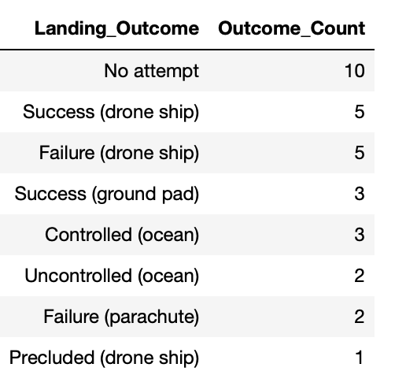
Rank Landing Outcomes Between 2010-06-04 and 2017-03-20
Query
Result:
Description:
The group by arranges the variable landing outcome into groups
The between and and filters the dates in the specified range
Count command counts the landing_outcome values and order by arranges the counted values in a decreasing order

Slide 32

Section 3

Slide 33
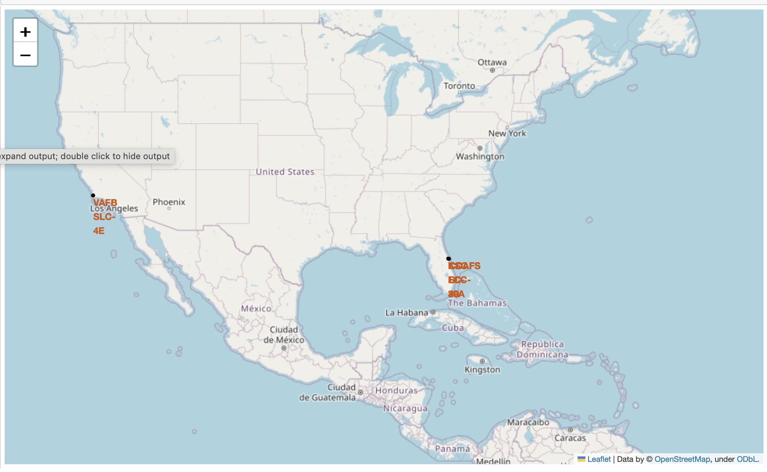
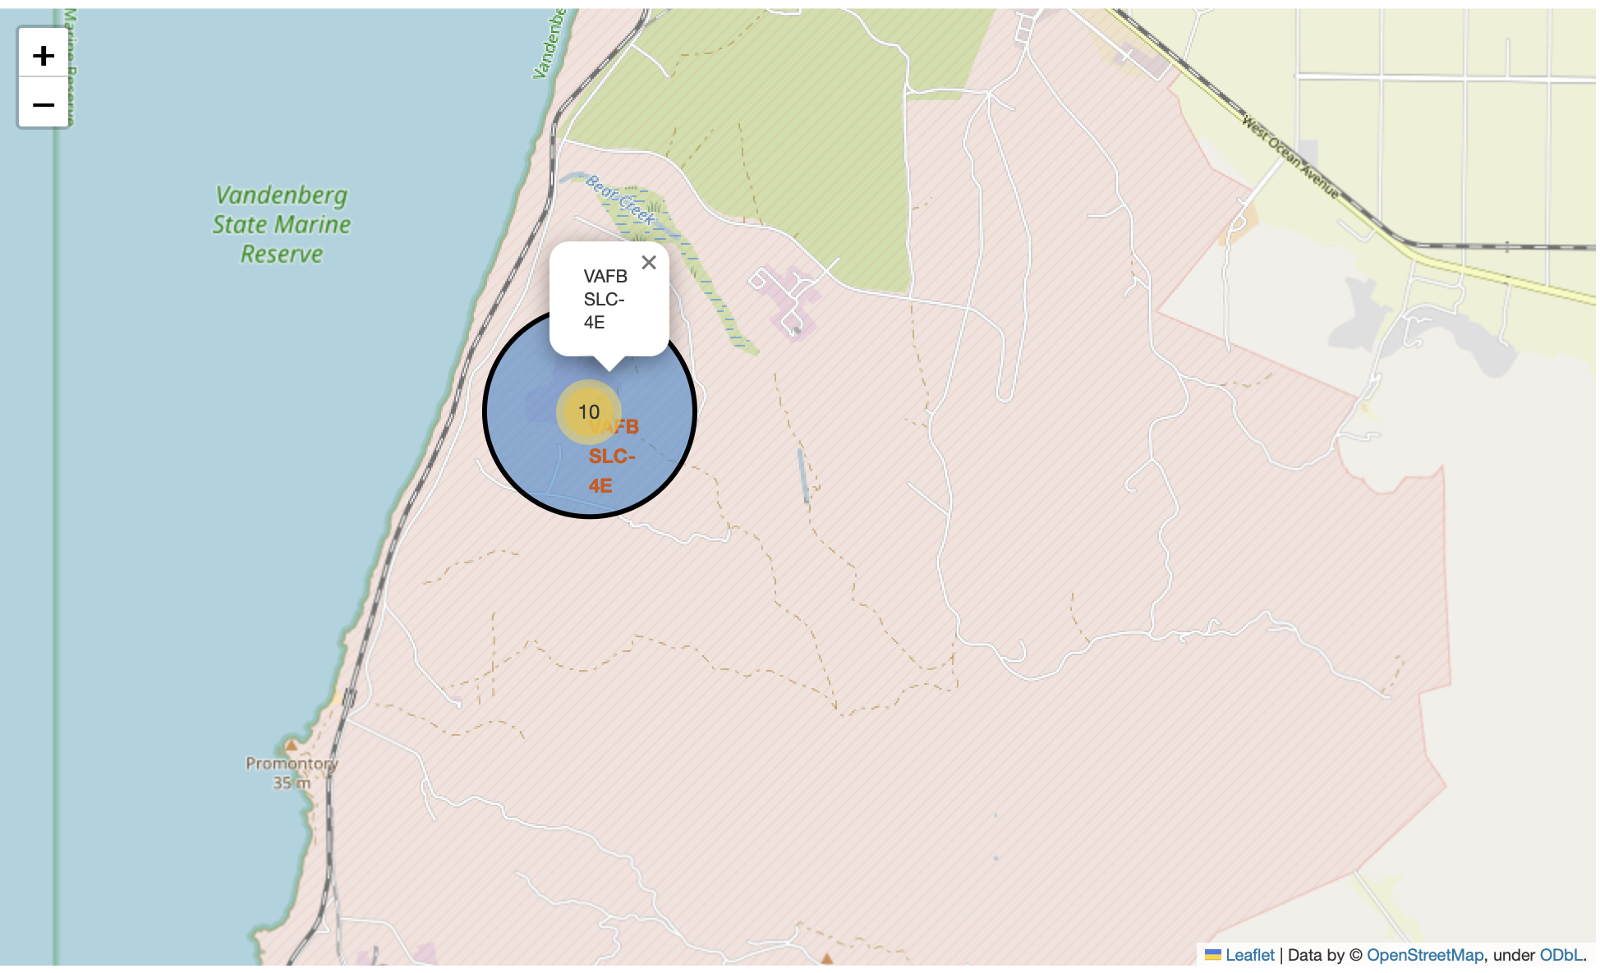
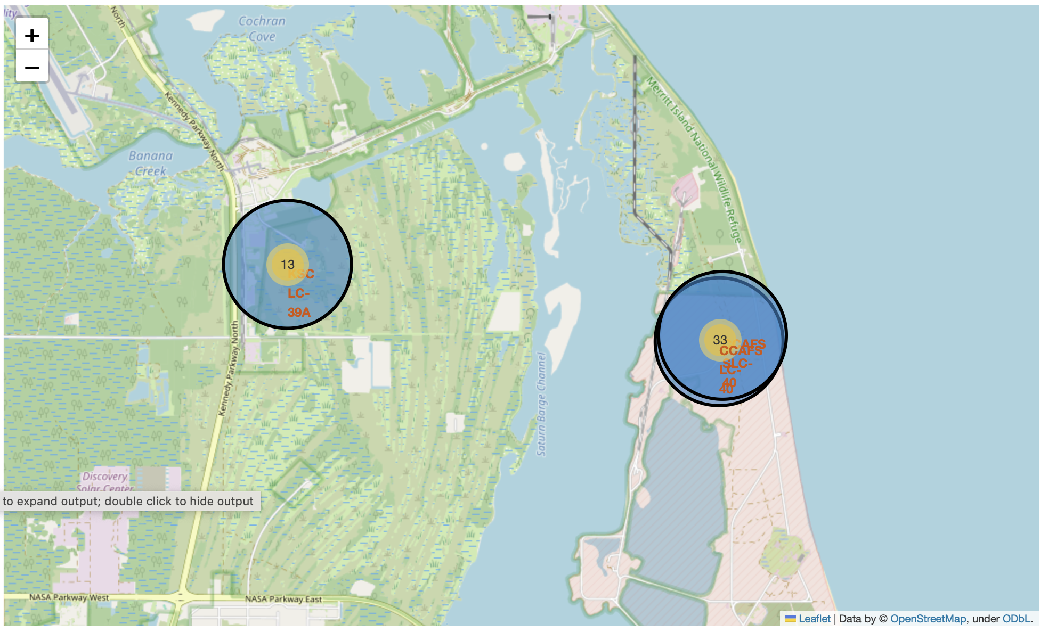
SpaceX Falcon 9 – Launch Sites Map
Figure 3 – Zoomed Point 2
Figure 1 shows the Global Map of the SpaceX Falcon 9 launch sites located in Florida and California in the United States of America (USA). Each launch site contains a circle, label and pop-up to highlight the location and name of the launch site. The figure shows that all launch sites are near the coast.
Figure 2 & 3 show a zoomed in location of the launch sites which overlap each other:
VAFB SLC-4E (California)
CCAFS LC-40 (Florida)
KSC LC-39A (Florida)
CCAFS SLC-40 (Florida)
Figure 1 – Global Map
Figure 2 – Zoomed Point 1

Slide 34
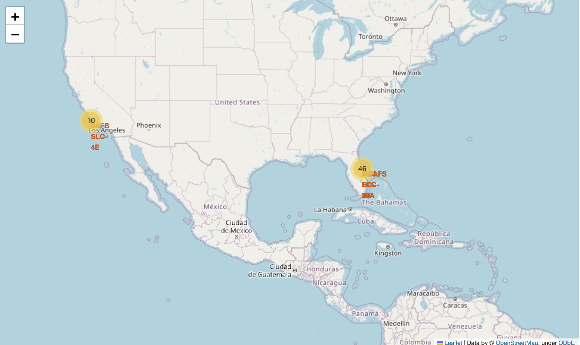
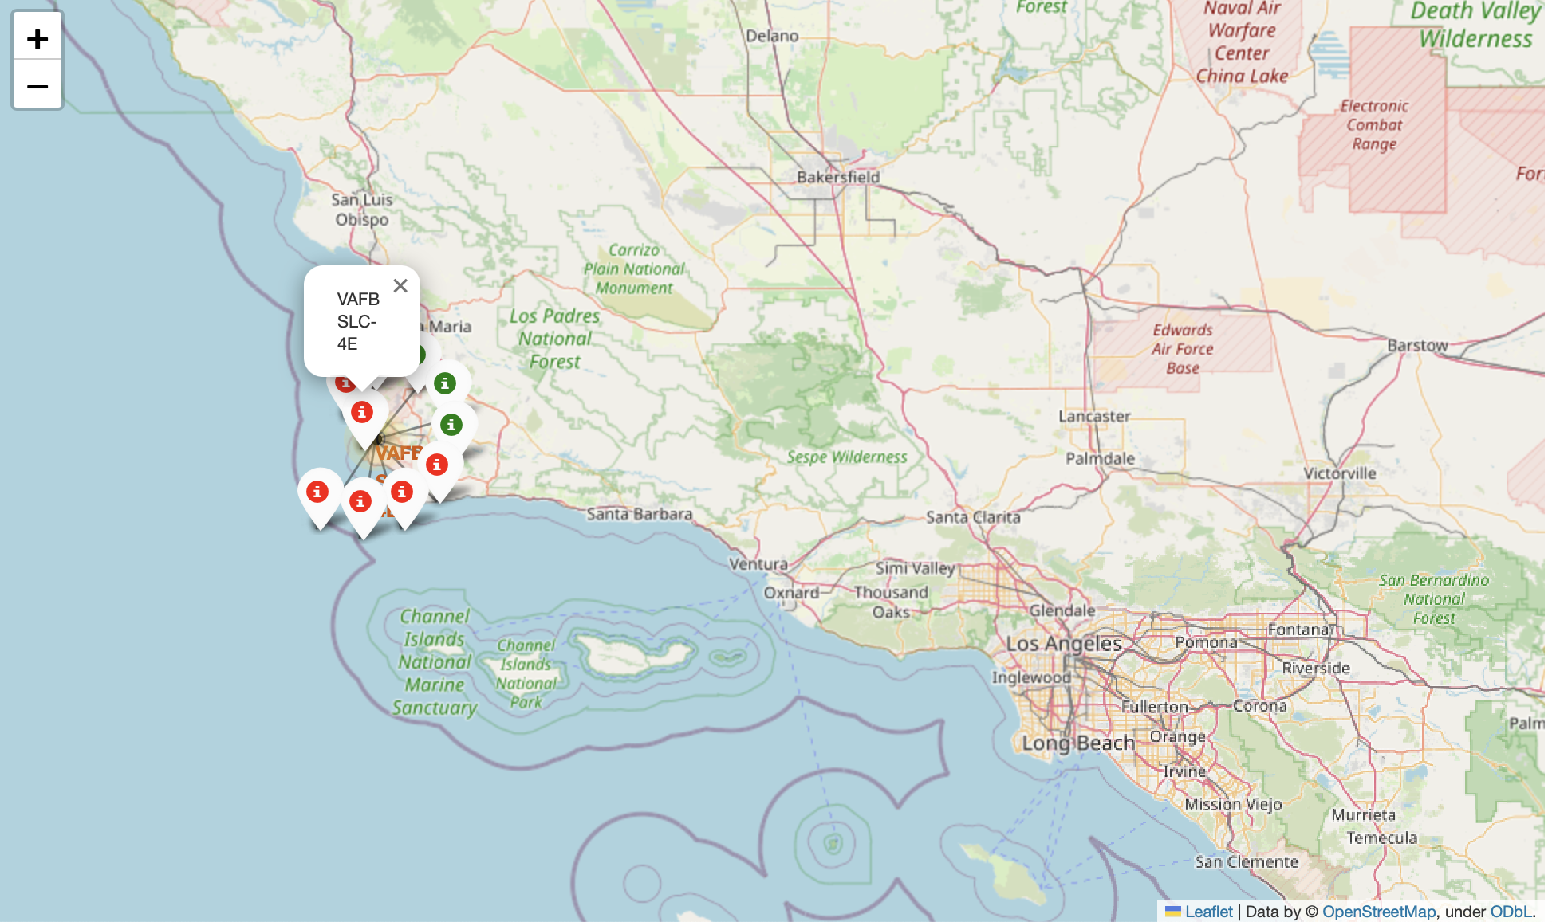
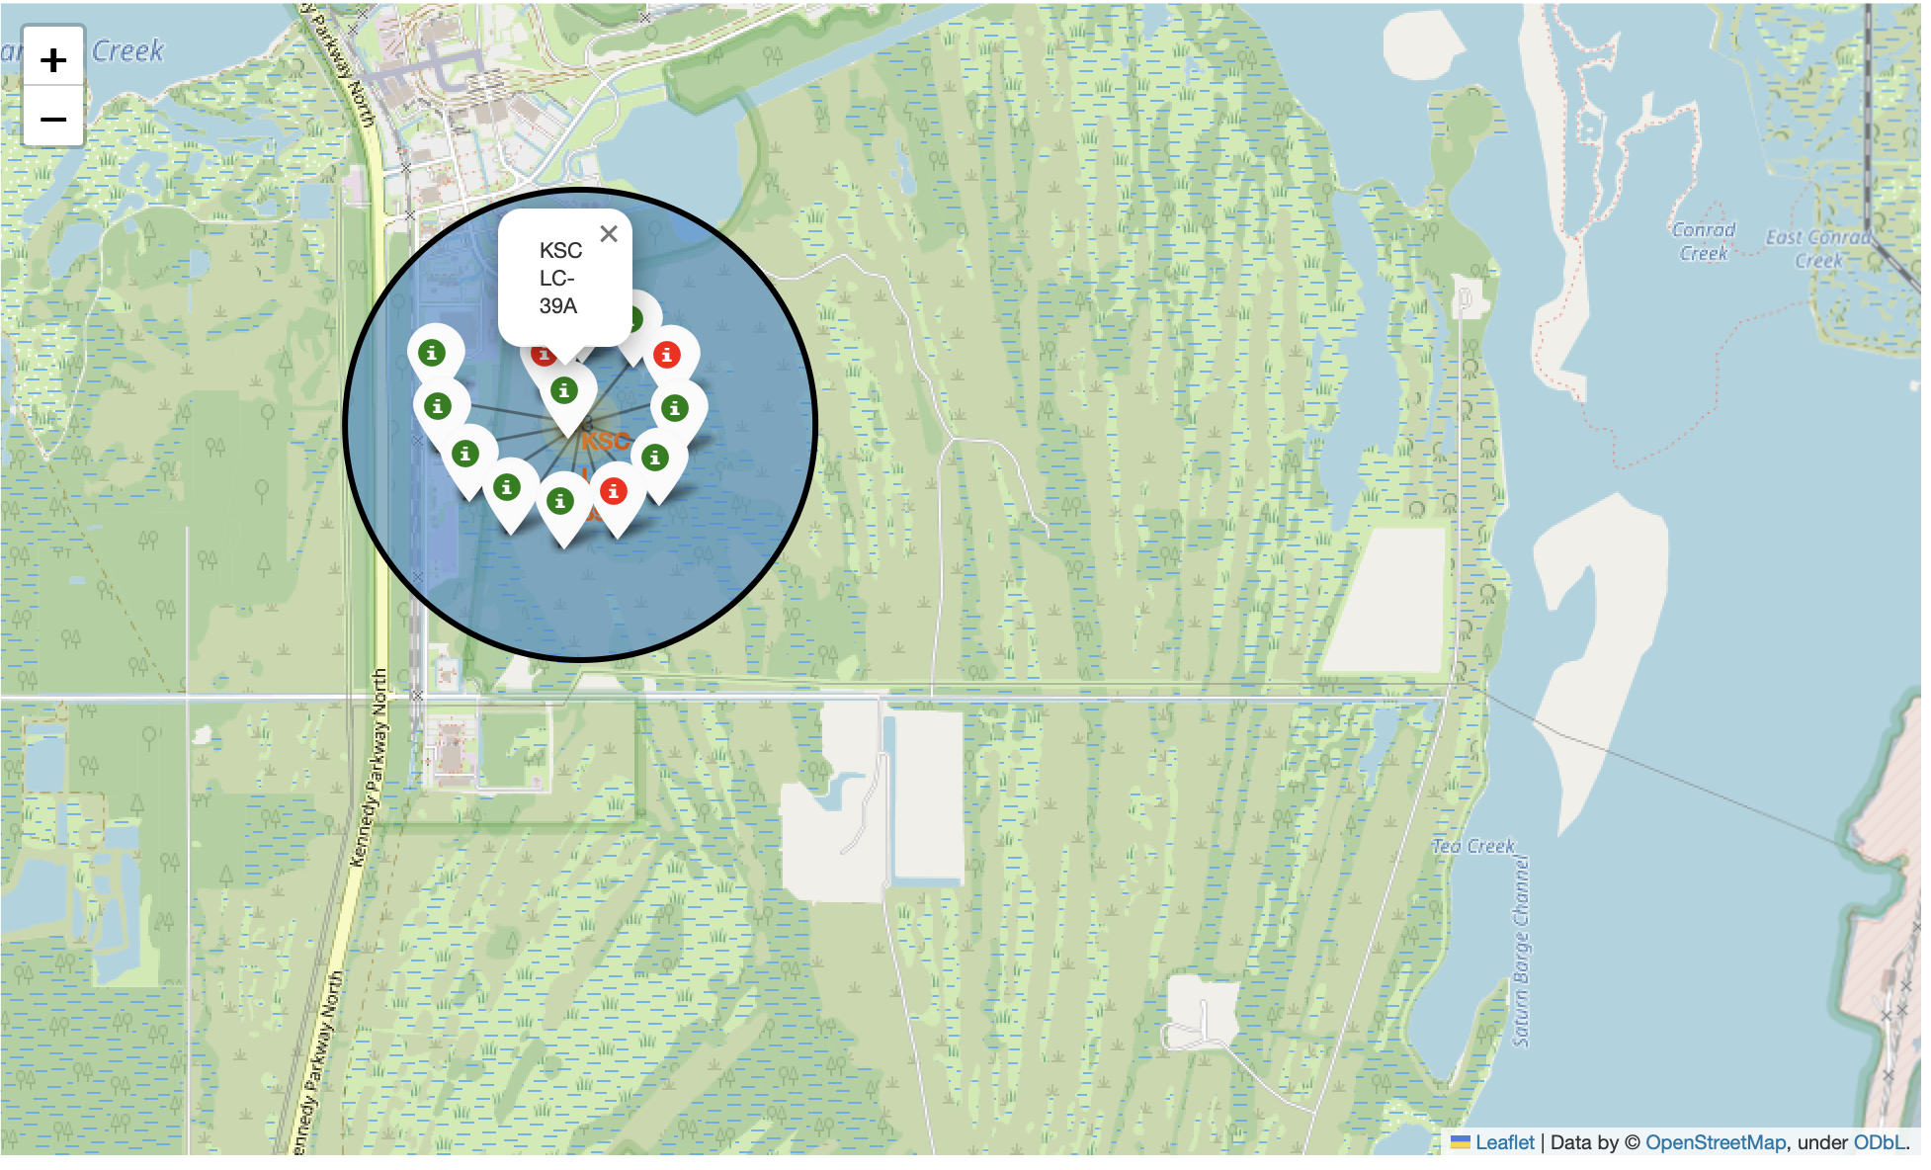
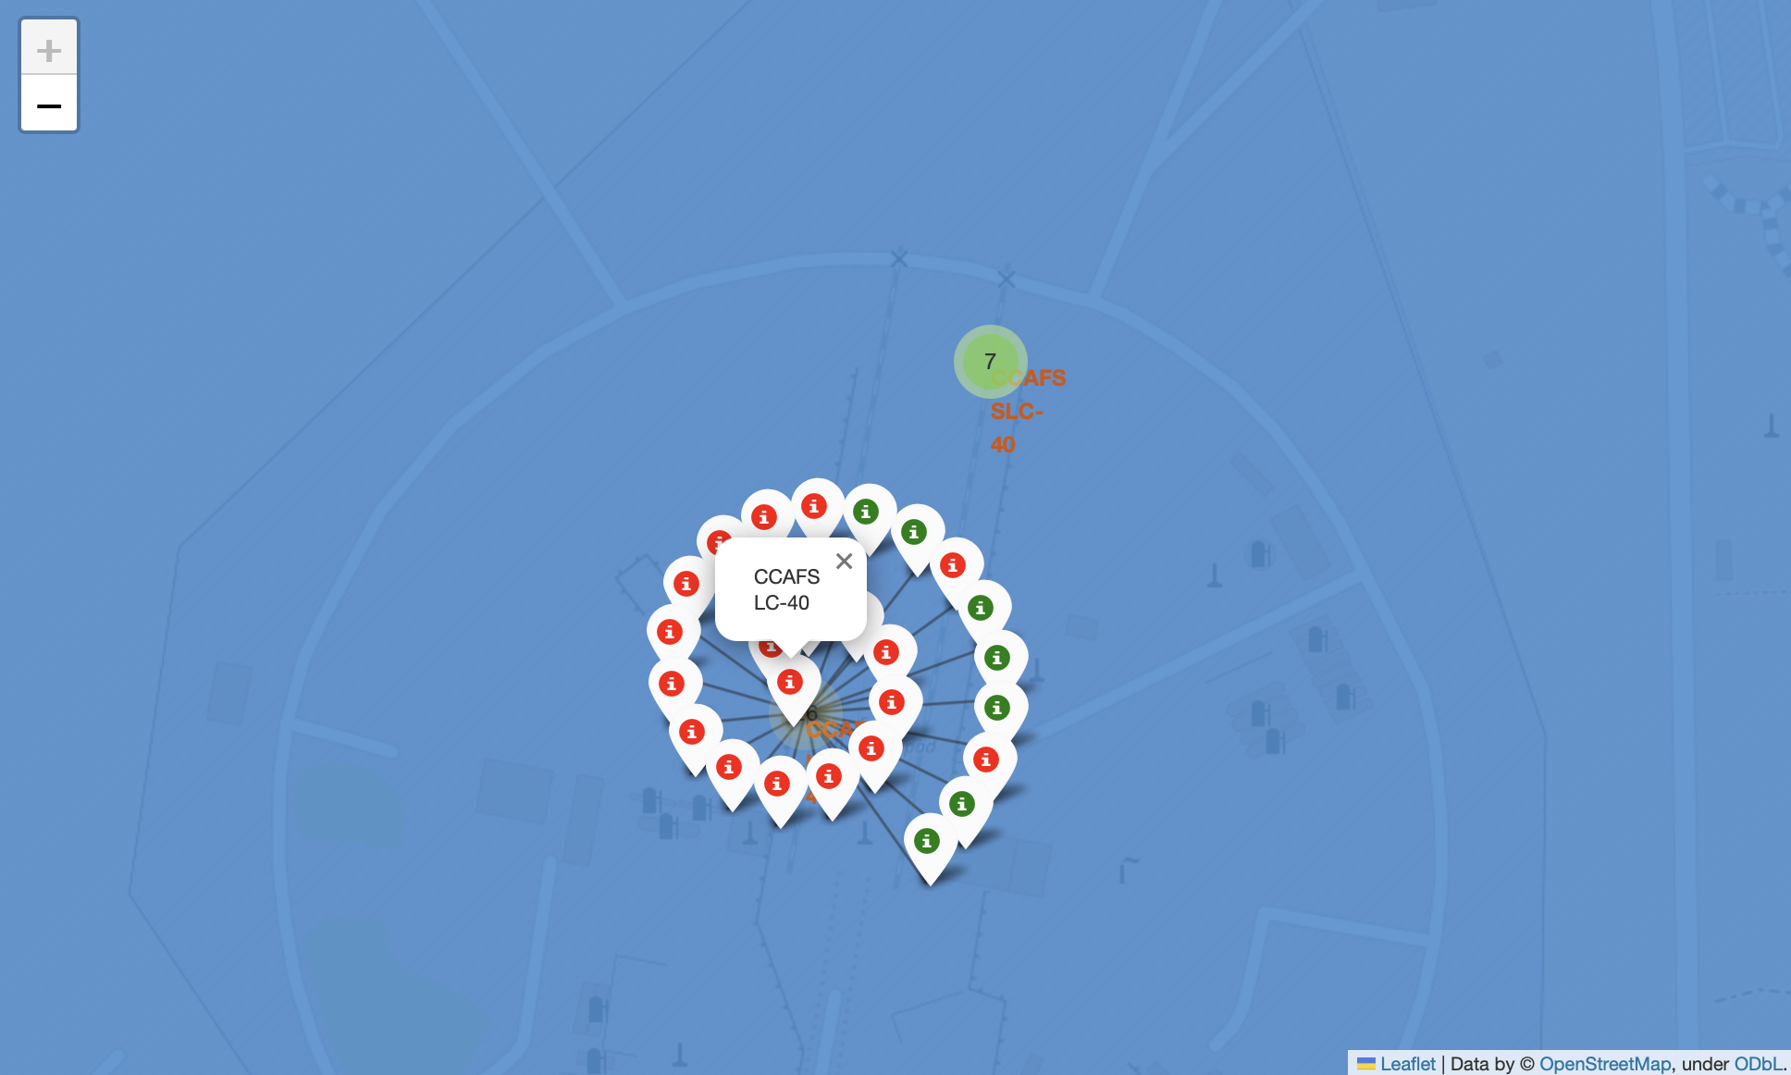
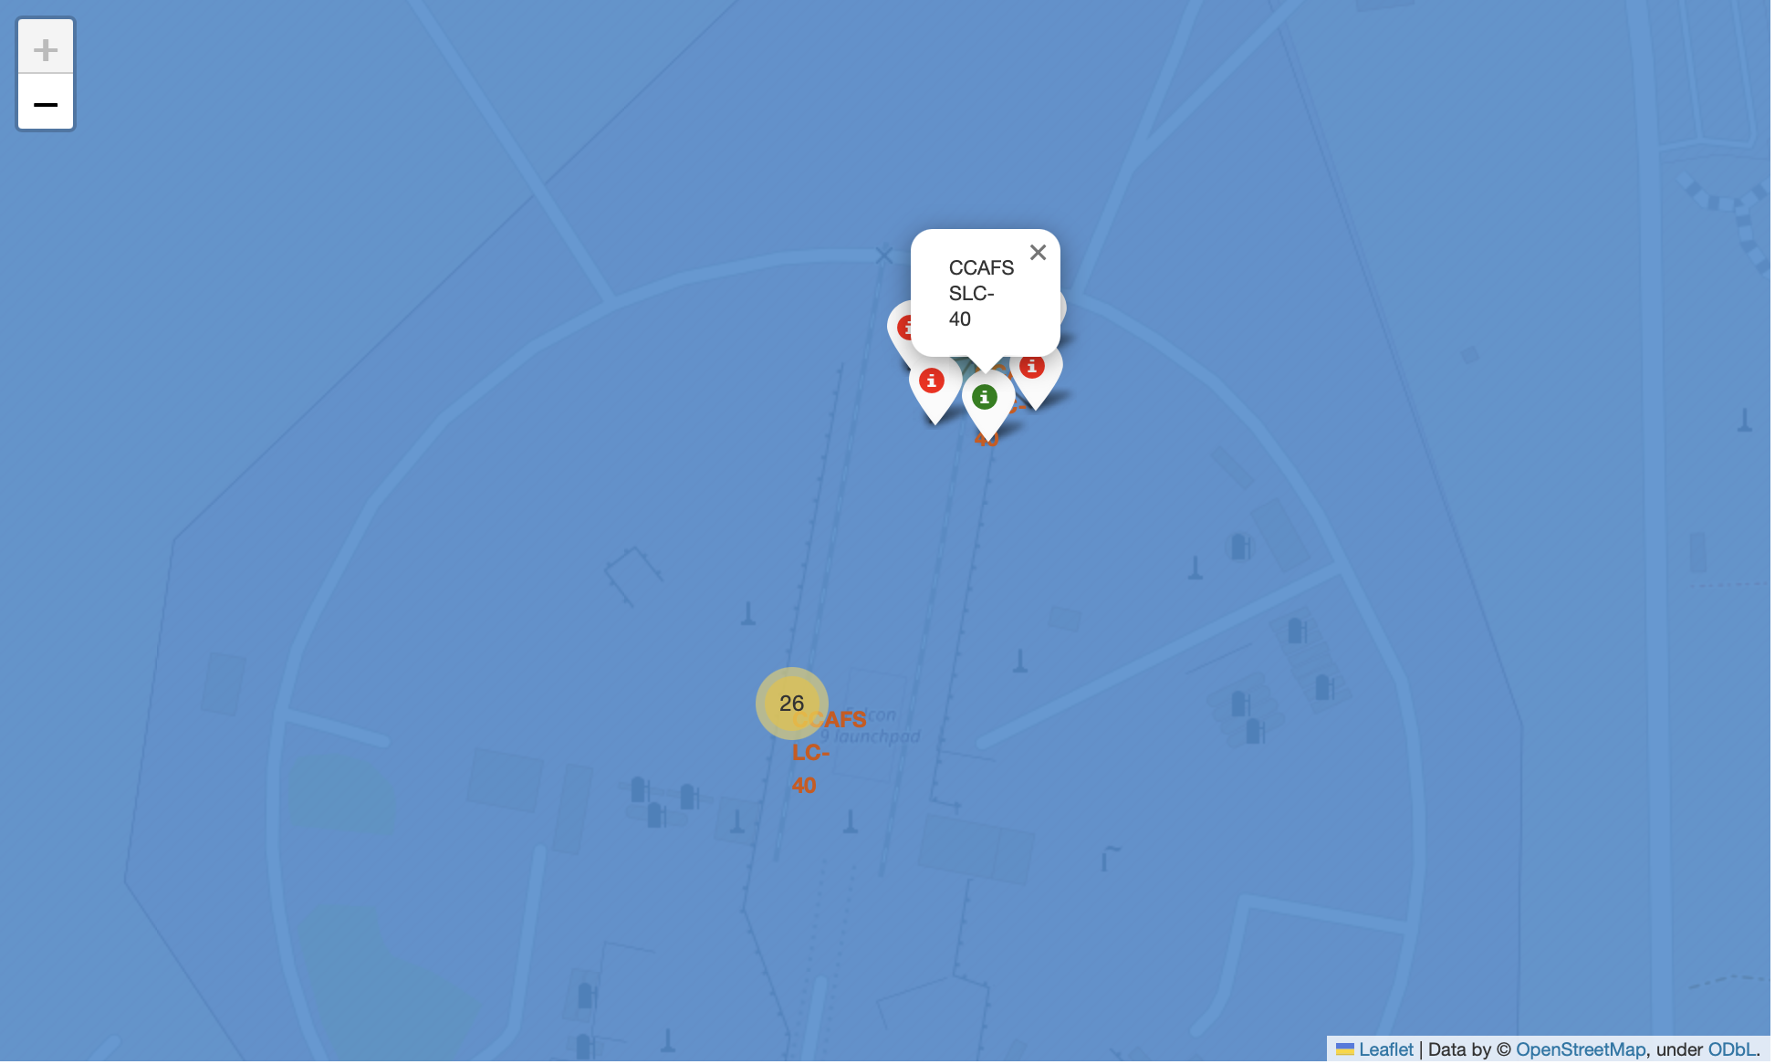
SpaceX Falcon – Launch Outcomes
Figure 1 shows the Global Map of the SpaceX Falcon 9 launch sites located in Florida and California in the United States of America (USA). Each launch site contains a circle, label and pop-up to highlight the location and name of the launch site. The figure shows that all launch sites are near the coast.
Figure 2 & 3 show a zoomed in location of the launch sites which overl
Fig 1 – Global Map with launch sites
Fig 2 – VAFB launch site with success/failed markers
Fig 3 – KSC LC 39A launch site with success/failed markers
Fig 4 – CCAFS LC 40 launch site with success/failed markers
Fig 5 – CCAFS SLC 40 launch site with success/failed markers

Slide 35
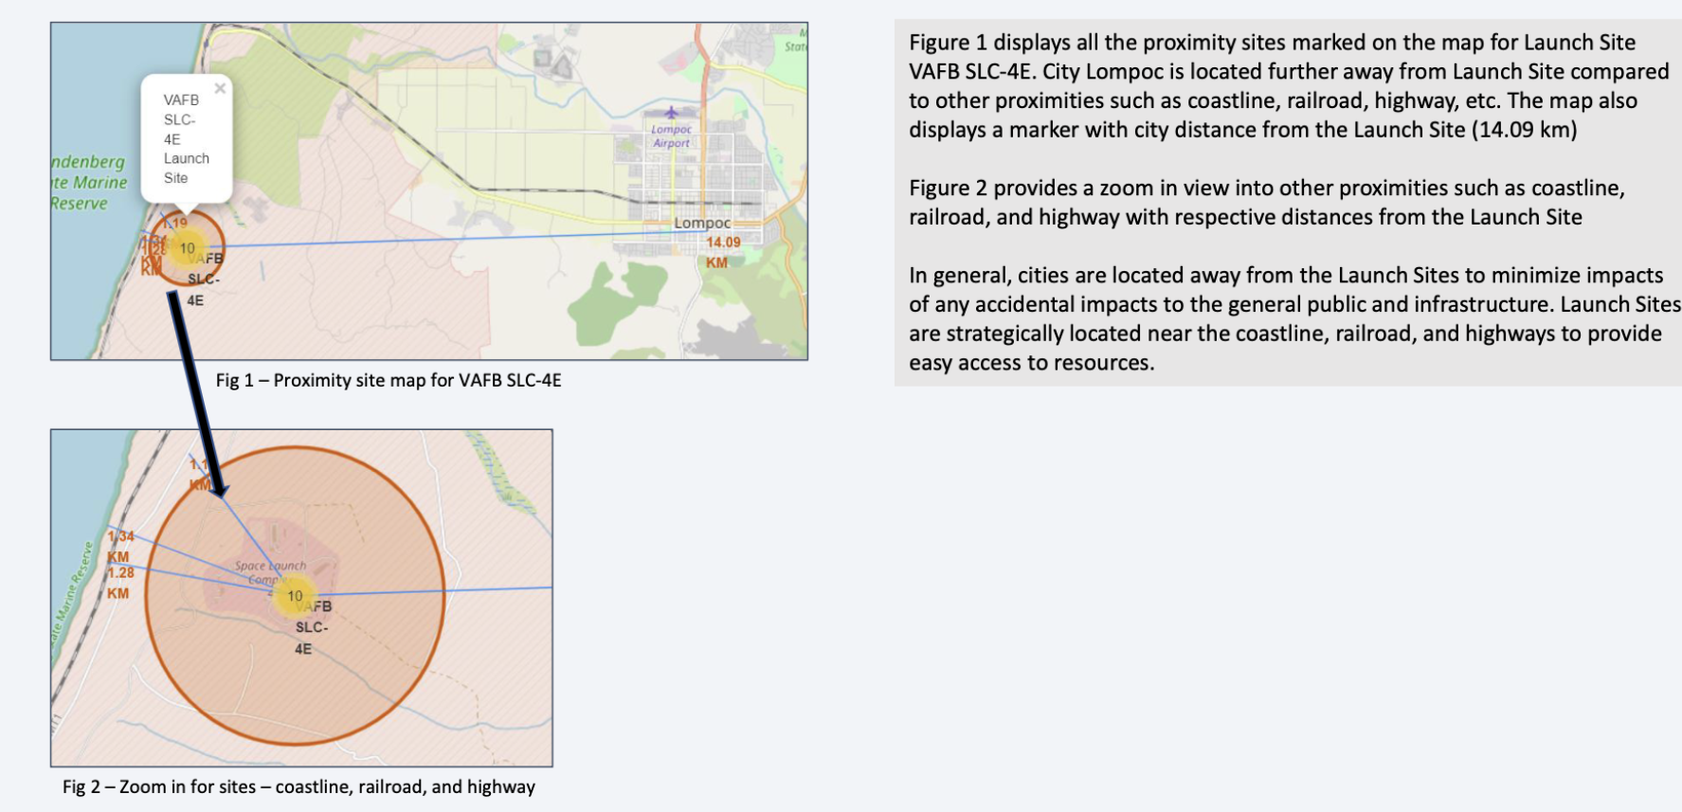
SpaceX Falcon X – Select Launch Site to its proximities

Slide 36

Section 4

Slide 37
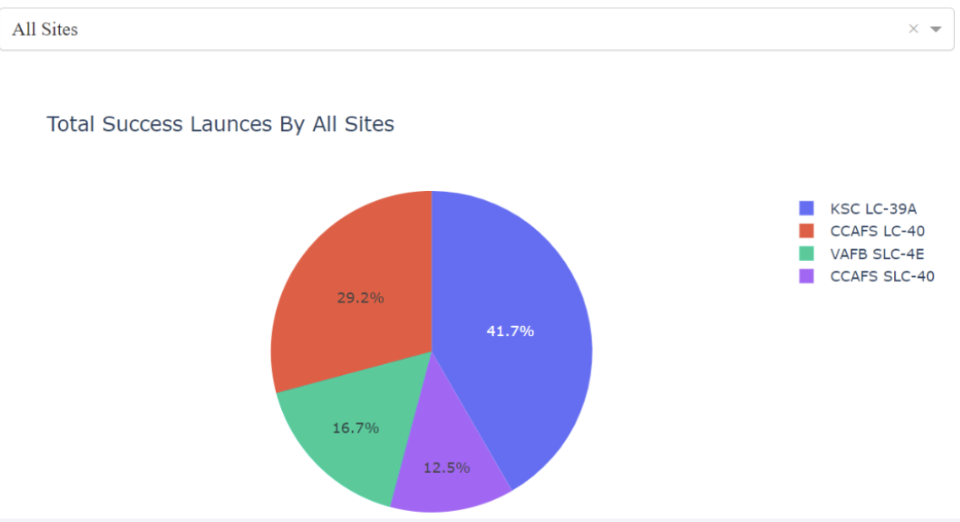
Launch Success Counts for all Sites
Launch site KSC LC 39A has the highest successful landing rate
Launch site CCAFS SLC-40 has the lowest successful landing rate

Slide 38
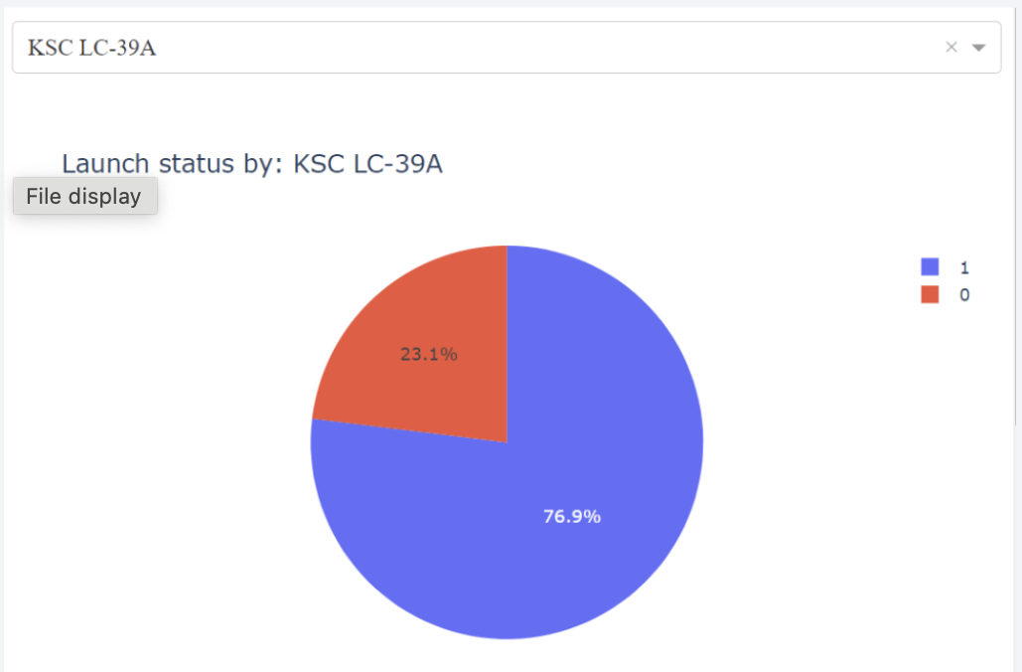
Launch Site with the Highest Launch Success Ratio
Launch site KSC LC 39A has the highest successful landing rate.
76.9% of the launches in KSC LC-39A landed successfully.
23.1% of the launches in KSC LC-39A failed to land successfully.

Slide 39
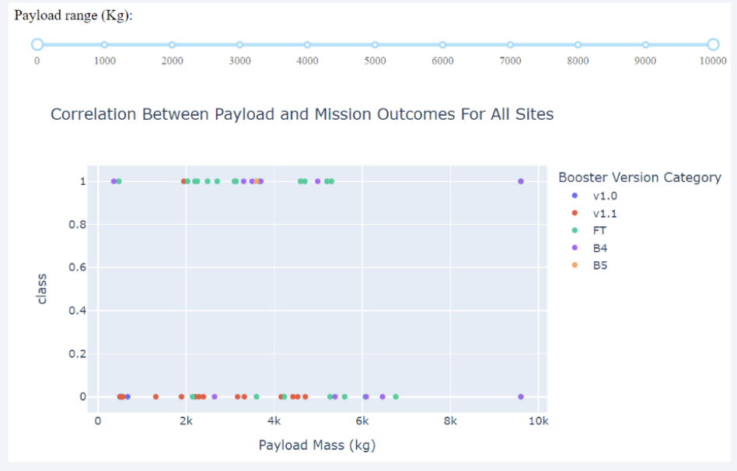
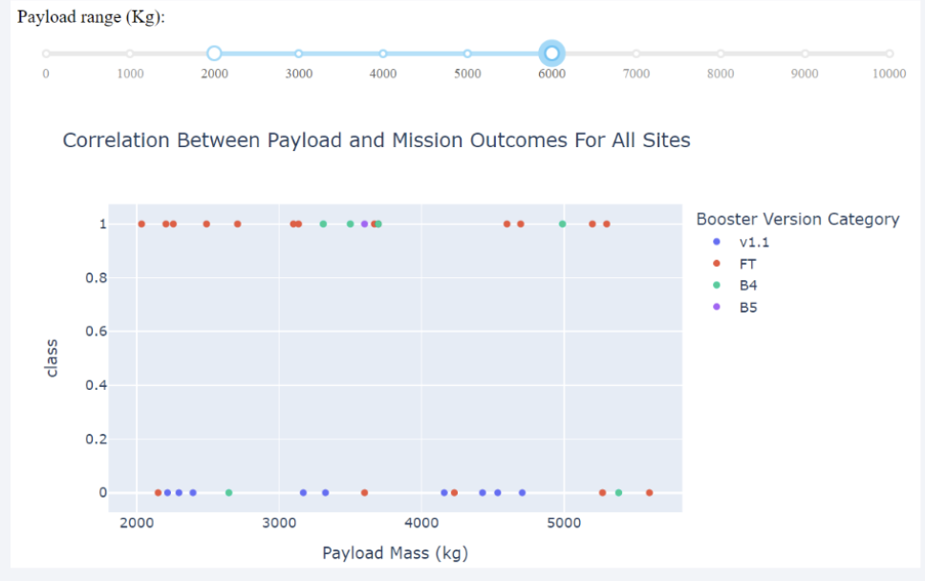
PayLoad vs Launch Outcome
The most successful launches are between Payload 2000 to 5500
Booster Version Category FT has the most successful launches.
The only booster with a successful launch with a Payload > 5500 is B4 and <2000 is B4 & FT

Slide 40

Section 5

Slide 41
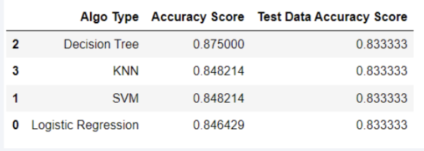
Classification Accuracy
Four classification models were used trained, namely:
Logistic Regression
Support Vector Machine
Decision Tree Classifier
K-Nearest Neighbor (kNN)
Results from training set for all the above-mentioned classification models show that Decision Tree Classifier has the highest training classification accuracy score of 0.8750.
The test set accuracy score show all the classification models have the same value of 0.8333.
Given that the accuracy scores of the train set show that decision tree is the highest, while the test accuracy is the same for all the models, then we may select Decision Tree Model. However, we may also need to reconsider adding more data points to increase the robustness of the models.

Slide 42
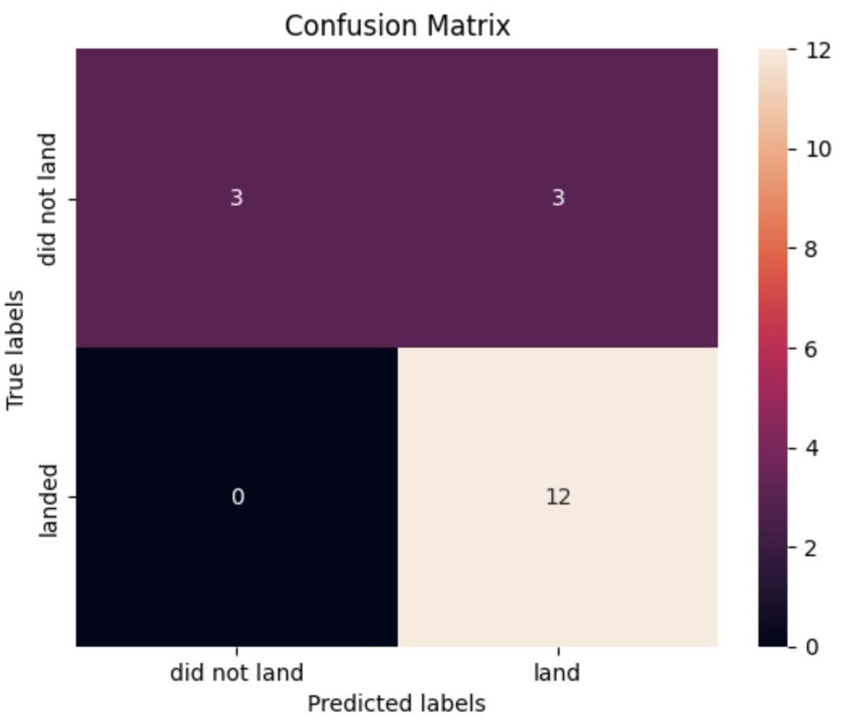
Confusion Matrix
The confusion matrix is the same for all the models (SVM, Logistic Regression, kNN and Decision Tree)
It shows that all 12 launches which landed successfully were also predicted to land successfully by the mode and thus are True Positives (TP).
It also shows that 3 launches which did not land successfully were predicted the same by the model and so are True Negatives (TN).
However, there are 3 launches which did not land successfully but the model predicted them to be successful and thus known as False Positives (FP).
Overall, the classifier is accurate up to 83.3% ((TP+TN)/Total) of the time and the misclassification error rate of the model is ((FP+FN)/Total) 16.7%.

Slide 43
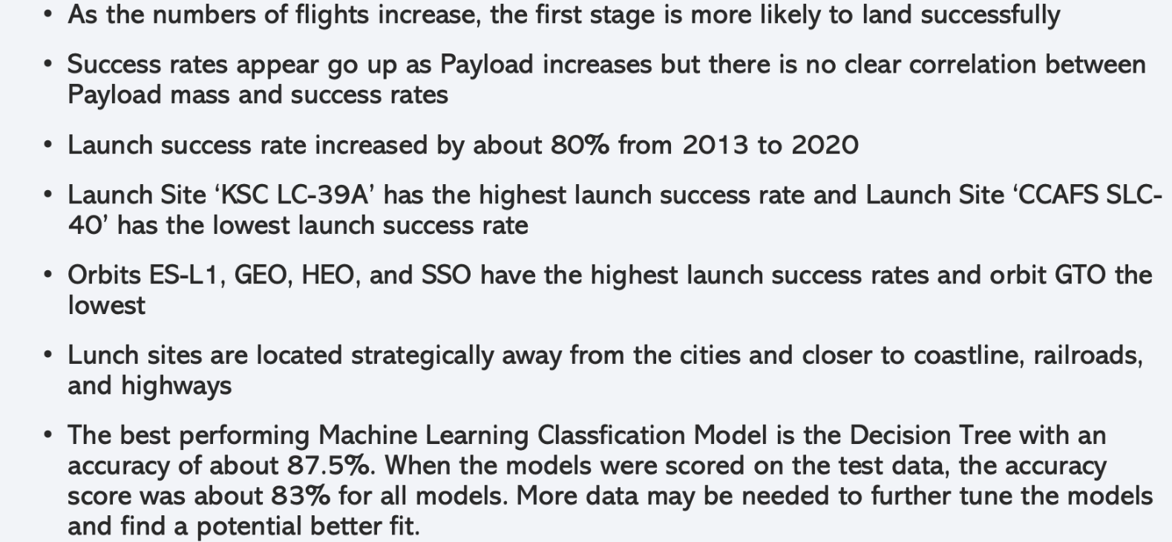
Conclusions

Slide 44
Appendix
Include any relevant assets like Python code snippets, SQL queries, charts, Notebook outputs, or data sets that you may have created during this project

Slide 45


